Slide 1
Towards a general meta-heuristic optimiser for vehicle routing: experiments on six VRP types
Dr Philip G. Welch
www.opendoorlogistics.com

Slide 2
Aims
A single VRP model & optimiser for different and novel real-world problems
Configurable by a non-specialist user
e.g. Excel user
Problem definable without restrictions on form of cost/constraint functions
Users write constraint functions in a language they understand
Exclude mathematical programming approaches…
Solution quality needs to be ‘good enough’
Useful not optimal
(Problem tailored approaches will be better)

Slide 3
Requirements
A way to describe a VRP model
Rich model?
Domain specific language (e.g. MARS)?
Efficient evaluation of a solution
Incremental evaluation
An optimisation algorithm
The hardest part by far…

Slide 4
Brief model description
Entities
Routes (actors) split into sections
Actions (stops or served arcs)
Events within actions
User defined functions
Like formula fields in Excel
Cost functions
cost(TimeWindowViolation, max(time() – lateTimeWindow , 0))
No restrictions placed on functional form

Slide 5
Brief model description
Each route modelled as a separate discrete event simulation (DES)
Supports incremental evaluation
Assume routes non-interacting
Route has a state
Quantities and current time held in the state
State also available for other objects
Actions (stops, serve) own events
Events can change state or add to cost
Set or add quantities, increment time…

Slide 6
Brief model description
Arbitrary cost functions available based on position and assignment (outside DES)
Half-way between rich VRP model and domain specific language
Similar approach to Drools Optaplanner (but more routing focused)
Solutions can be evaluated for:
Deterministic not stochastic problems
Single (hierarchical) objective only
Decision variables assignment & position only

Slide 7
Optimisation techniques
Top VRP solvers based on combination of local search heuristics and meta-heuristics
Move single action, swap single action, etc…
Simple local search heuristics insufficient for complex positional constraints
e.g. periodic, pick-up deliver…
Constraints create many local optima
Greedy search becomes easily stuck
Solvers use problem-specific heuristics
Periodic problem – switch visit pattern
Pickup-deliver – specialised insert move

Slide 8
Optimisation techniques
Mathematical programming approaches have mathematical problem description
Allows systematic exploration of solution space
Branch & bound (integer programming)
Constraint propagation (constraint programming), ….
Our user-defined constraint functions have no restrictions on functional form
…no mathematical description
Can’t use constraint propagation etc…
Avoid writing problem-specific heuristics
Without assuming constraint functional form can the engine learn to optimise them?

Slide 9
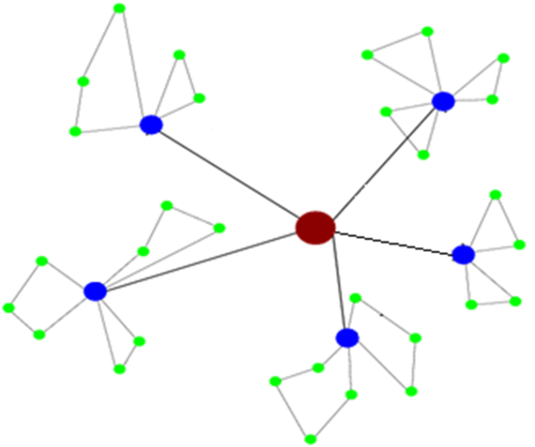
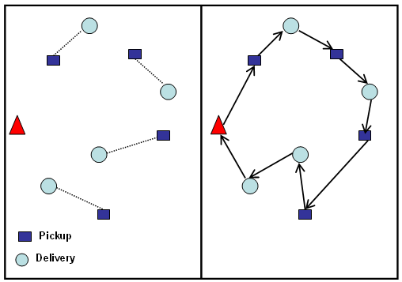
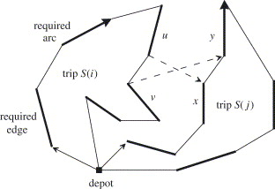
Types of routing problem with requests
Request: a single service demand with one or more actions available to satisfy it
2-echelon problem
Move item hub→depot then move item depot→customer
(image www.ads.tuwien.ac.at/w/Image:2e-lrp.png)
Pickup-deliver
Pickup item then deliver item
(image Hosny & Mumford 2010)
Arc-routing
Serve forwards or serve backwards
(image Belenguera et al. 2006)

Slide 10
Assignment & relative position (ARP) constraints
ARP space: within a single request, consider assignment of actions to routes and their relative positions (before/after). Separate space per request
Problem | Actions in request | ARP Constraints
2-echelon | |depots| x L1 move to depot 1 x L2 serve customer | 1 x L1 action loaded (chosen depot) L2 action on route belonging to chosen depot
Arc routing | 1 x serve edge forward 1 x serve edge backward | 1 x action loaded
Periodic | n actions | Patterns specifying combinations of days Each route has a day
Pick-up deliver | 1 x pickup 1 x deliver | Same route Relative position - pickup before deliver

Slide 11
M1 disjoint search
‘Learns’ assignment & positional constraints
Request R with actions a_{i} ∈ R
R owns user-defined constraints C
C is function of assignment & relative positions only
Relative position between 2 actions : -1, 0, +1
Analyse ARP constraints using inputs/outputs
Identify disjoint regions when moving one action a time
e.g. changing route for a pick-up deliver pair
Build set of ARP start points S
Moving from one to another causes constraint violation
Explore using greedy multi-start search in ARP space

Slide 12
M1 disjoint search – start points generated for problems
Problem | Actions in request | Start points generated
2-echelon | |depots| x L1 move to depot 1 x L2 serve customer | One start point per depot
Arc routing | 1 x serve arc forward 1 x serve arc backward | One with forward loaded One with backwards loaded
Periodic | n actions | Number of start points ≤ number of visit patterns
Pick-up deliver | 1 x pickup 1 x deliver | One start point per route

Slide 13
M1 disjoint search
ARP start points generated in ARP space
Solution contains only single request
Full optimisation performed in full space
Solution contains all requests
For each start point in a request
Move actions to start point positions
For each action
Calculate feasible assignments and relative positions arp_{i} ∈ P (can be cached)
Move to best full space position p_{j} ∈ arp_{i}
Efficiency is problem dependent
Reusability of search results from different start points? (100% for 2-ech, CARP, PDVRP)

Slide 14
Experiments
Optimiser engine components:
M1 disjoint search for move
Swap, two-opt improvement heuristics
Controlled by genetic algorithm (hybrid)
Experiments on 2-echelon, CARP, periodic, pickup-deliver and single action problems – VRPTW and multi-trip VRP.
Java implementation.
Max runtime 30 minutes on 4-6 CPUs.
Performance compared to more problem-tailored approaches?

Slide 15
Results (multi-action requests)
Problem type | Sets | # of requests | # inst | # same vehicles | # <= BKS | RPD from BKS
2-echelon | Perboli et al. Crainic et al. | 50 (omitted < 50) | 69 | n/a | 25 (7 better) | 0.56%
 | Hemmelmayr et al | 100 (omitted > 100) | 12 | n/a | 0 | 7.41%
CARP | val, egl | 39-190 | 58 | n/a | 32 | 1.42%
Periodic VRP | Cordeau | 20-192 (omitted > 200) | 37 | n/a | 9 | 2.97%
Pickup deliver VRPTW | Li & Lim | 100 | 56 | 53 | 35 | 0.50%
 |  | 200 | 60 | 24 | 7 | 7.41%

Slide 16
Results
Performance relative to BKS dependent on # of requests in problem
‘Good performance limit’ L
~ 100 ≤ L < 200 (lower for 2-ech)
Deviation from BKS ~ 0.5-3%
Similar results for single action request problems
Multi-trip VRP & VRPTW

Slide 17
Comparison to other approaches
Compared to other (meta) heuristic VRP solvers
Less specialised
Can’t handle larger instances (yet)
Optimises broader range of problems than other models without including problem specific heuristics
Compared to general approaches - mathematical programming techniques
More specialised (assume routing problem)
Handles larger instances

Slide 18
Conclusions
Whole model occupies ‘niche’
Competitive solution quality for small-to-medium size problems whilst solving wider problem range
More work needed for larger instances
M1 disjoint search most useful outcome
Simple technique easily applicable to other VRP models
Simple move heuristic can optimise more complex positional constraints
Work needed on cases where search results re-usable between start points
Best insertion caching?

